Slide 1

Customer Segmentation using K-Means
Transforming Customer Data into Actionable Insights
Shubham Vigoniya

Slide 2

CONTENTS
THE BUSINESS PROBLEM & PROJECT GOAL
DATA OVERVIEW AND FEATURES
DATA CLEANING AND FEATURE ENGINEERING
FEATURE TRANSFORMATION & SCALING
CLUSTERING METHODOLOGY: K-MEANS
FINDING THE OPTIMAL K: THE ELBOW METHOD
SEGMENTS
STRATEGIC RECOMMENDATIONS FOR MARKETING
CONCLUSION & NEXT STEPS

Slide 3
THE BUSINESS PROBLEM & PROJECT GOAL
Problem: Need to move beyond generic marketing and personalize customer engagement.
Goal: Group customers based on purchasing behaviour and demographics to define targetable segments.
Expected Value: Higher campaign ROI, improved customer retention, and tailored product strategy.

Slide 4
DATA OVERVIEW AND FEATURES
Source: customer_data.csv (2240 records, 29 features)
Key Data Categories:
Demographics: Income, Age, Education, Marital_Status.
2. Product Spend: MntWines, MntMeatProducts, Total_Spent.
3. Engagement: Recency (Days since last purchase), Campaign Acceptance (AcceptedCmp1-5).

Slide 5
DATA CLEANING AND FEATURE ENGINEERING
New Features Created:
1. Age (Calculated from Year_Birth).
2. Total_Spent (Sum of all product spend columns).
3. Total_Children (Sum of Kidhome and Teenhome). –
Handling Missing Data: Imputed 24 missing Income values using the median to maintain distribution integrity.
Outlier Management: Noted and addressed outliers in Year_Birth (e.g., min 1893) and extreme Income values.

Slide 6
FEATURE TRANSFORMATION & SCALING
Marital Status Consolidation: Simplified rare/inconsistent categories (Absurd, YOLO, Alone) into Single for cleaner segmentation.
Categorical Encoding: Used LabelEncoder for remaining categorical features (Education, Marital_Status).
Feature Scaling (Standardization): Applied StandardScaler to all numerical features to prevent features with larger scales (like Income) from dominating the K-Means algorithm.

Slide 7
CLUSTERING METHODOLOGY: K-MEANS
Model Choice: Unsupervised learning via K-Means Clustering.
Mechanism: Iteratively groups data points by minimizing the Within-Cluster Sum of
Squares (WCSS). - Input: The final set of scaled, cleaned, and engineered features.

Slide 8
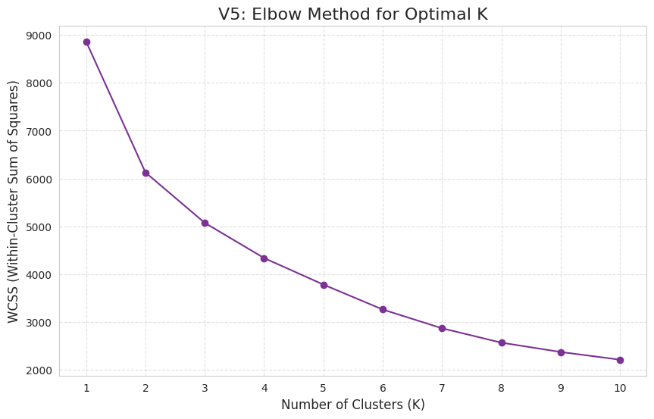
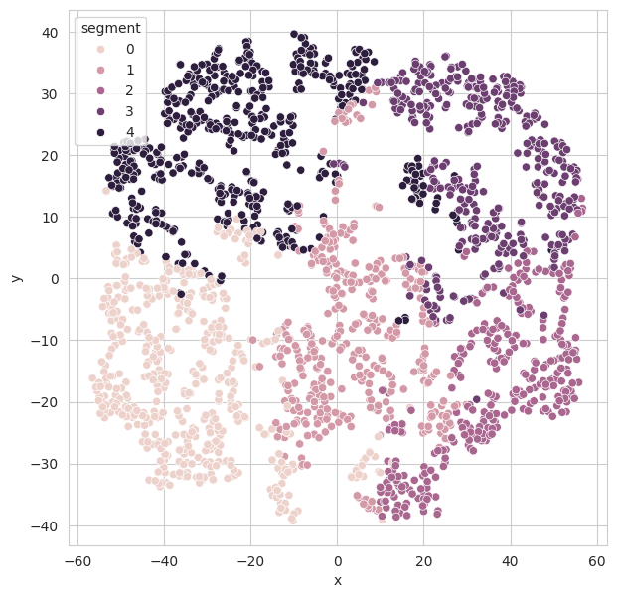
FINDING THE OPTIMAL K: THE ELBOW METHOD
Analysis: Performed the Elbow Method to evaluate WCSS for K values from 1 to 10.
Result: The elbow point indicates that K=3 or K=4 are the optimal number of clusters.
Decision: K=4 was chosen for a slightly finer, more actionable segmentation.
Optimal value of K
Cluster k = 4 color label map

Slide 9
SEGMENTS
Segment 0: The Affluent Spenders (High-Value):
Size: Smallest segment (e.g., 16.1% of the total base).
Traits: Highest Income (~88k), Highest Total_Spent (~$1,257).
Behaviour: Low Recency, zero children at home, high success rate in major campaigns (especially Cmp5).
Focus: Premium products, personalized luxury offers, exclusive loyalty status.
Segment 2: The Established Spenders (Loyal Mid-High):
Size: Second smallest segment (e.g., 14.9%).
Traits: High Income (~68k), High Total_Spent (~$903).
Behaviour: Highly engaged (low Recency), high rate of Catalog Purchases.
Focus: Cross-selling, retaining loyalty, targeted campaigns to increase overall spend frequency.

Slide 10
Segment 3: The Average/Mid-Market.
Size: Mid-sized segment (e.g., 23.6%).
Traits: Average Income (~51k), Mid-range Total_Spent (~$401).
Behaviour: Moderate engagement across all channels, lower campaign response rate than the top two groups.
Focus: Promotional deals, increasing basket size, conversion campaigns for high-margin categories.
Segment 1: The Budget-Conscious Family.
Size: Largest segment (e.g., 45.3%). - Traits: Lowest Income (~29k), Lowest Total_Spent (~$46), highest Kidhome.
Behaviour: High number of web visits (deal hunting), lowest purchase frequency.
Focus: Price-sensitive offers, family bundles, driving in-store traffic with discounts.

Slide 11
STRATEGIC RECOMMENDATIONS FOR MARKETING
Targeted Budget Allocation: Focus the majority of high-cost, personalized campaigns on Segments 0 and 2 (High-Value).
Campaign Design: Segment 1 needs value/necessity-focused messaging; Segment 0 needs exclusivity/premium messaging.
Product Strategy: Develop product lines or bundles specifically to capture more wallet share from Segments 1 and 3.

Slide 12
CONCLUSION
Based on the Elbow Method analysis, the optimal number of clusters for segmenting this customer data is likely K=3 or K=4.
K=3 provides a strong, simple segmentation into groups that may represent Low-Value, Mid-Value, and High-Value customers.
K=4 offers a slightly finer segmentation, potentially separating High-Value customers into "New" (low recency) and "Loyal" (high recency) groups.

Slide 13
THANK YOU

